Slide 1
DETAXING
Decentralized taxi experiencing using blockchain
Guide:MS ROSE MARY MATHEW
RESHANA M M
4 TH SEM MCA B BATCH

Slide 2
CONTENTS
Relevance of the topic
Description
Objectives
Existing and Proposed System
Input/output and Modules
System Design

Slide 3
Description
DeTaxing is a Decentralized taxi experiencing using blockchain is a Community-based Taxi Booking system built on Blockchain which allows drivers to
rid on various nearby ride requests with an optimal amount within the
application recommended price range.
It is focused on giving back their old fashioned independent taxi service
along with the touch of the latest technology.
The proposed system help the customers to book the vehicles or cab for
travelling.
It doesn’t have any third-party access, which makes the system
transparent and reliable , also can directly contacted by the driver and
customer.
Implemented in blockchain, the features of it provides more secure to this application. No tampering can be done throughout the entire data process
in the application

Slide 4
Relavence
Taxis play an important role as a transportation alternative in many cities.
Many online taxi booking applications are available in our society but this we proposed as an overcome to it.
Implementing the oldest fashioned in newest technology like blockchain, A blockchain is a decentralized ledger of all transactions across a peer-to-
peer network.
There is no brokerage fee is included in it, so it helps the driver and the
user to get the benefits of it.
Enables more security features in it, so it makes feels more safer and comfortable to the users.

Slide 5
Objectives
The aim of this project is to avoid the third party access.
Its aims to feels more secure to users while they used to book a cab for travelling.
Its helps the users to get rid of paying excess amount for their needs.
Its aims to provide a 24*7 service to the society.
Enabling an emergency alert system.
Implementing a fare calculator.

Slide 6
Proposed System
In this proposed system, we avoid the entire concept of third party.
So there is no brokerage fees.
Data's are stored in database and personal data's are stored using
blockchain technology provides more secure to data without any loss.
implementing a fare calculator, we can avoid the arguments between the driver and passenger after the travel regarding the fare and users can only pay the actual cost.
It provide a emergency alert by sending a mail with current location.
All the money transfer will be performed using Ether in Ethereum
A smart contract will be created to track and view money transfer using
solidity

Slide 7
Existing System
Cab booking application is already existed like uber,ola etc. Those are
controlled by third parties.
Taxi-hailing companies like Ola and Uber have less influence on Autos and taxis in the rural and semi-urban which leads to unconditional pricing of
rides and many Rider/Customer – related problems
It does not provide the mode payment through cash. If the payment is online ,it direct towards the third party and only a less percentage is given to the drivers.
The user need to pay more than 50% as brokerage fees.
The data transfer using this application can be tampered.
There is no tracking for the payments to ensure its credited or not.

Slide 8
Input/Output and Modules
Taxi booking
Check location of all taxis from database
Get nearest taxi
Choose destination
Sent request to taxi
Calculate fair and show to user
When taxi accept request create a add this to smart contract
Trip
User update status
Get continues location using GPS
If emergency button clicked sent location to mentioned mail
When reaching the destination check contract and confirm
Payment
User pay using ether with private key
Driver updates payment status
Add information to contract

Slide 9
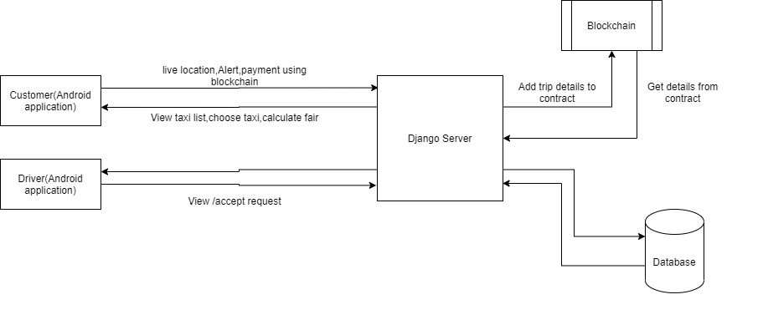
System design

Slide 10
THANK YOU

